Slide 1
Module 12

Slide 2
When we breath in, we lift our ribs and flatten our diaphragm, and as a result chest cavity becomes larger.
Because of this air is sucked into the lungs and fills the expanded alveoli.

Slide 3
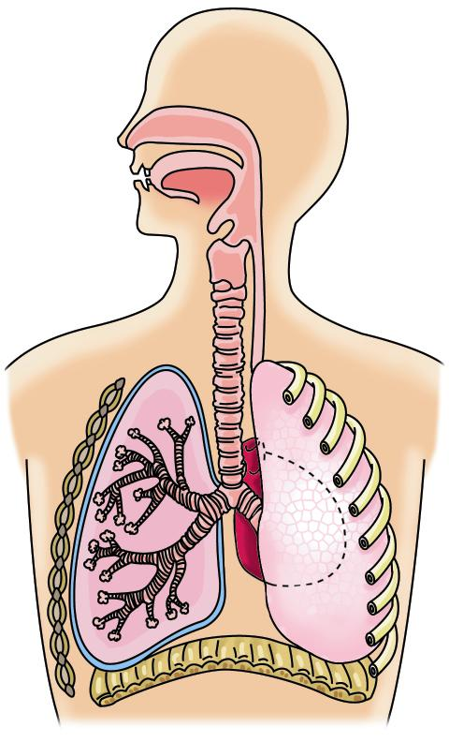
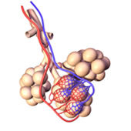
Alveoli
The thin walls of the alveoli are closely surrounded by a
network of blood capillaries
Branches of wide pipe
Branches of bronchi
Thin blood vessels
Balloon like sacs
Bronchi
Bronchioles
Alveoli

Slide 4
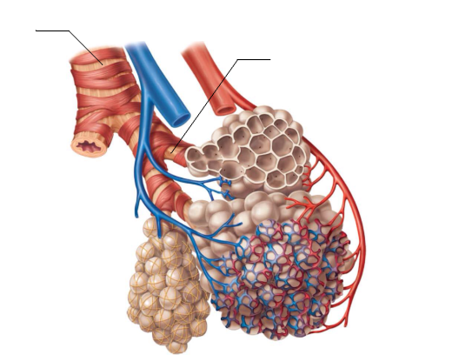
Let us see how exchange of gases takes place.
At the same time, CO₂ from the tissues is taken up by haemoglobin and is released into the alveoli by diffusion.
During breathing oxygen enters the lungs and then into alveoli.
The alveoli are surrounded by blood capillaries which contain blood.
The haemoglobin present in the RBC’S of the blood absorbs oxygen from the thin walls of the capillaries.
This oxygen is carried to all the tissues of the body.
This CO₂ goes out of the body when we breathe out air.
Body cells
RBC
CO₂
Blood capillary
Hb
O₂
O₂
Alveoli
CO₂
Alveoli

Slide 5
Haemoglobin helps in exchange of gases between the alveoli and the surrounding tissues.
So haemoglobin is also called as respiratory pigment.
During the breathing cycle, when air is taken in and let out, the lungs always contain a residual volume of air so that there is sufficient time for oxygen to be absorbed and for carbon dioxide to be released.

Slide 6

Exchange of gases in Plants
Plants do not have respiratory organs.
Plants are stationary.
So their energy requirement is less.
Fixed at one place
So the process of respiration is slower as compared to animals.
Higher concentration to lower concentration
So there is very little transport of gases.
The gases are exchanged by the process of
Diffusion.

Slide 7


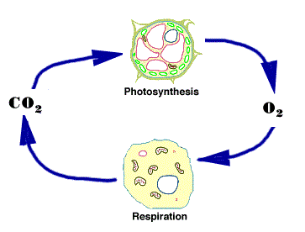
During day time :
Due to open stomata respiration and photosynthesis is simultaneous.
CO₂ is used for photosynthesis.
During
O₂ is released.
O₂
CO₂ is given out
O₂ is utilized for respiration
CO₂

Slide 8



During night time :
No Photosynthesis
More CO₂ is eliminated
Photosynthesis
No O₂ is released.
CO₂
During respiration
Respiration

Slide 9
Thank You

